Slide 1
ISSIP Course
Jim Spohrer
January 27, 2025
(DRAFT EXAMPLE)
Recording: https://youtu.be/ixyT-67IPvE
Notes:
Service is central to all value cocreation
We want ISSIP to make that point clearly.
Markus webpage – coordinate (build up-structure and need service systems thinking)
Come from the strategy of each company…
Strategy – strategy – strategy
Service
Adesso – 10K software company

Slide 2
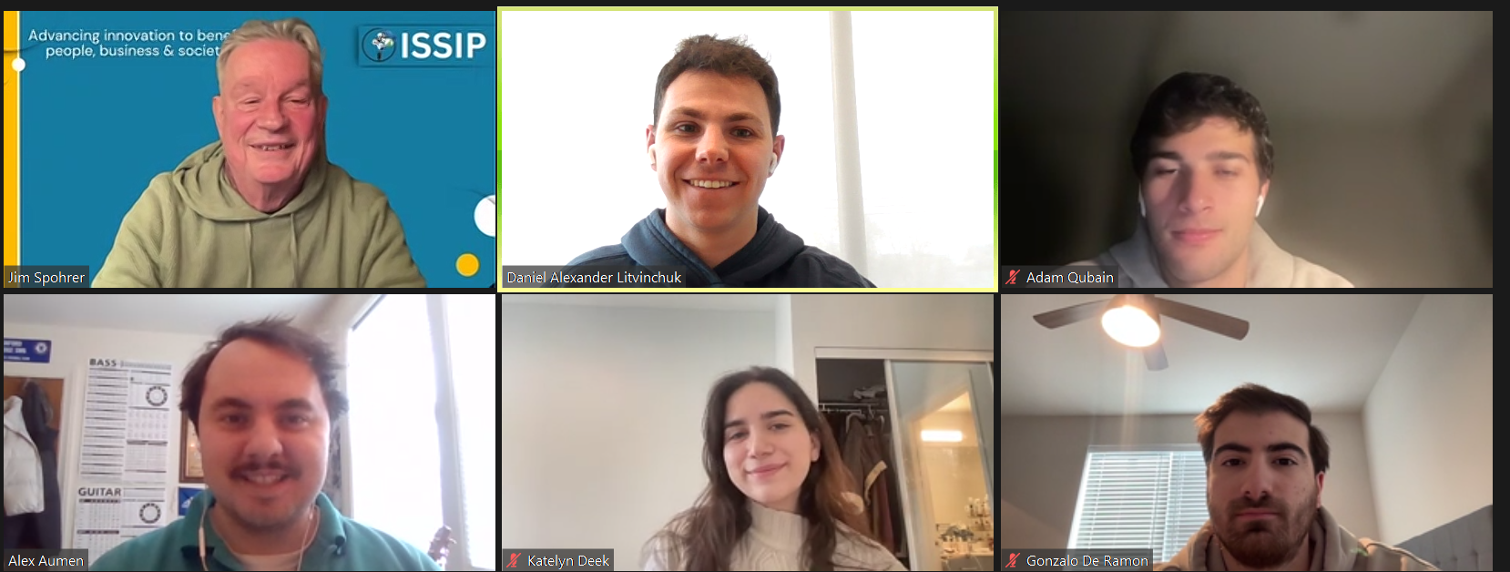
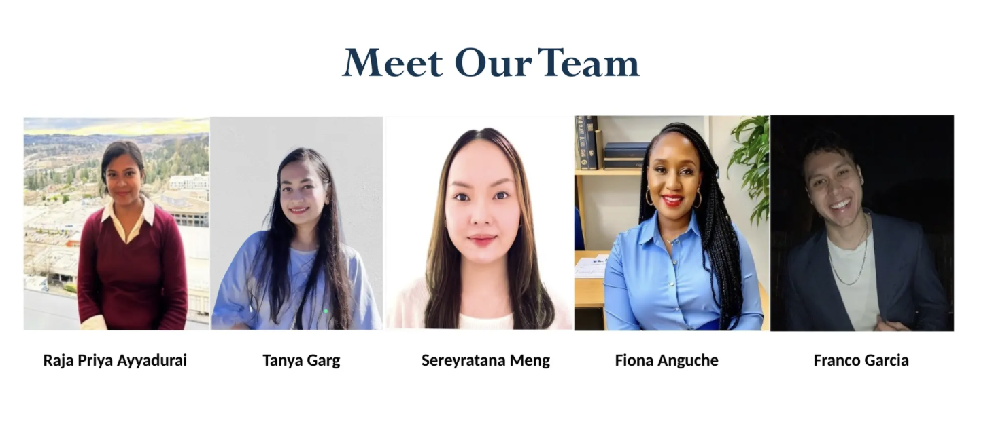
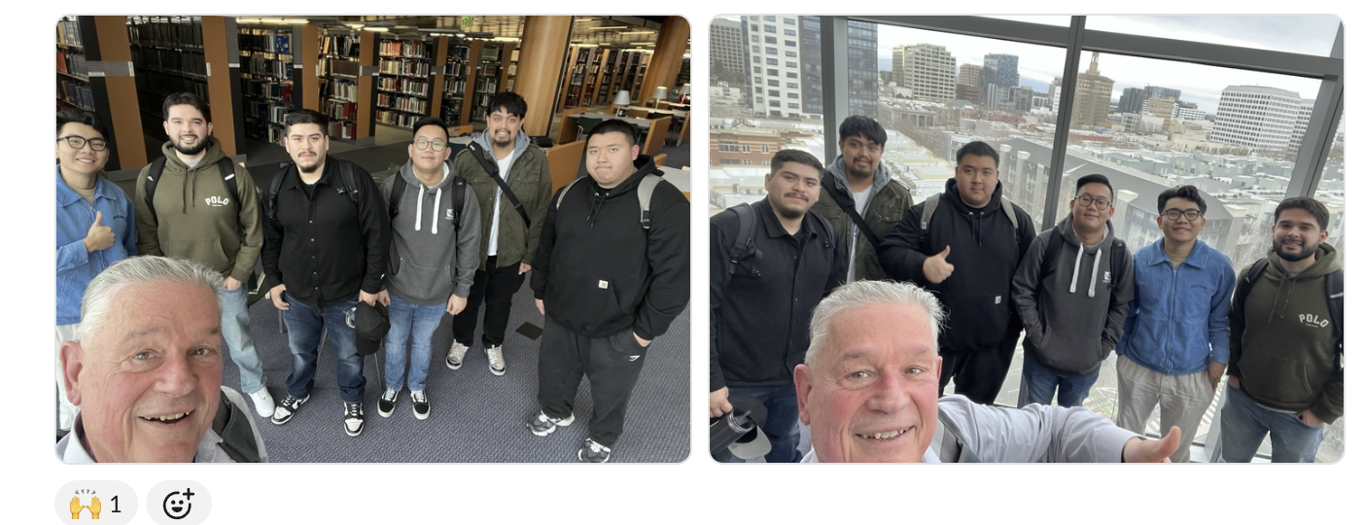
Penn State University Team
(Learning Factory – Industrial Engineering )
U Washington Tacoma Team
(MS Business Analytics)
San Jose State University Team
(Management of Information Systems)

Slide 3
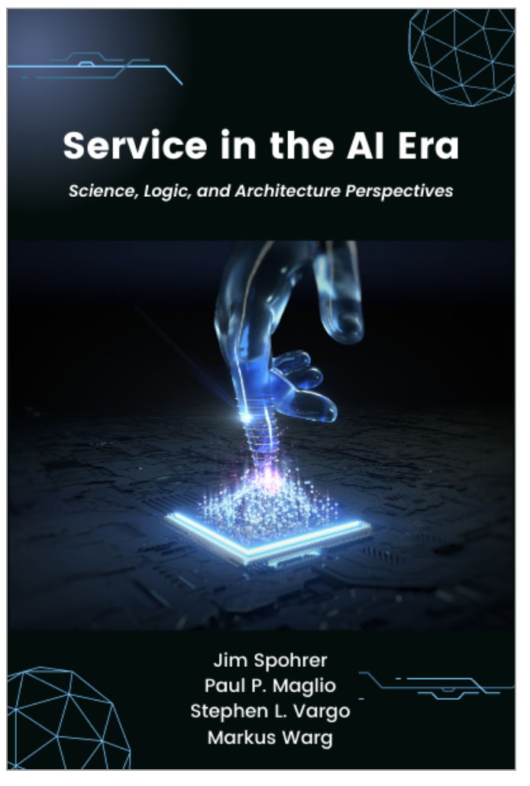
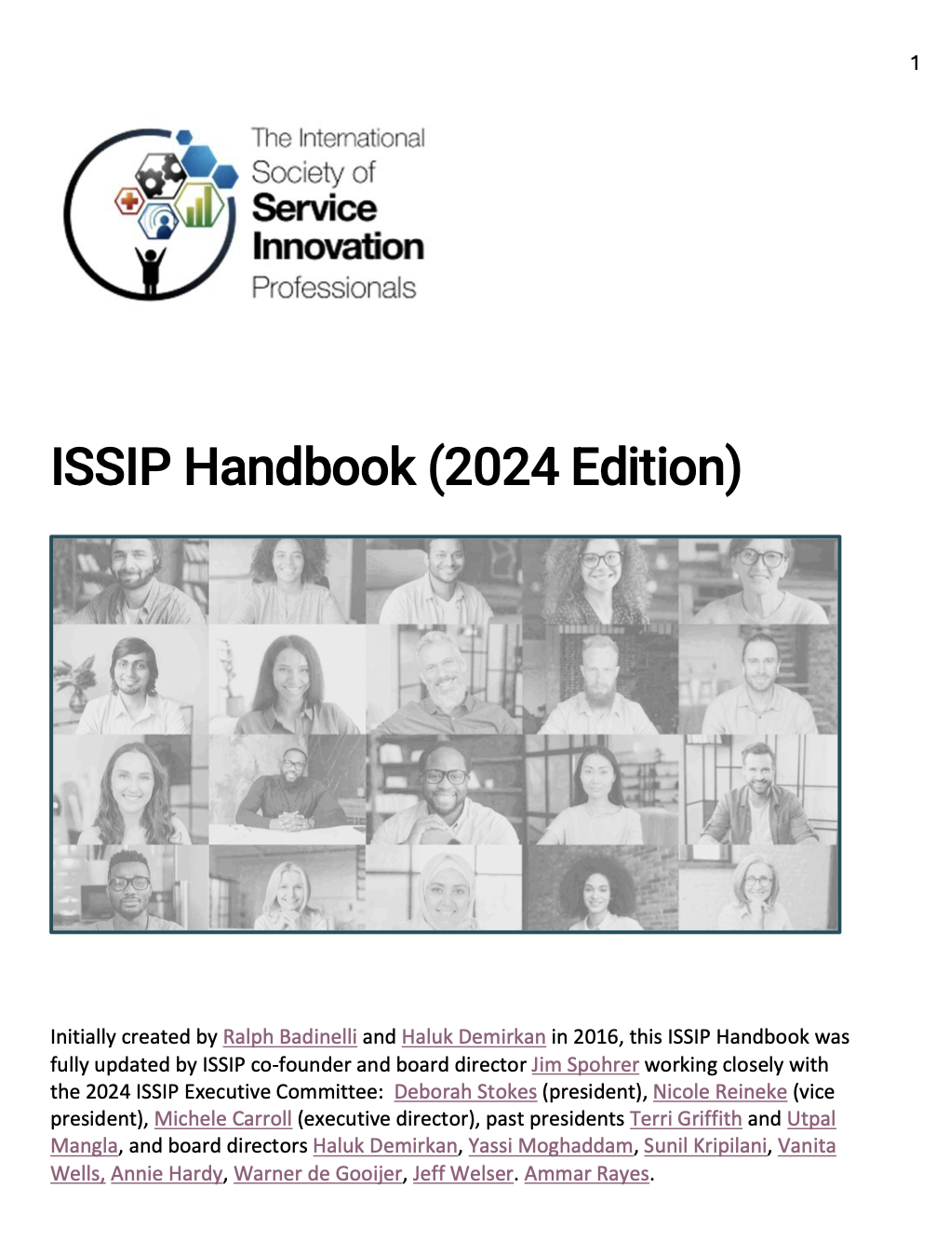
General Information
Two primary sources for courses content include:
Section A: Concepts
Sections B & C:
ISSIP & Participation
Time: One Hour
This course should take just one hour or less to complete, including taking the pre-test and post-test
Section A: Concepts - Ten Learning Items
Concepts is based loosely on the book “Service in the AI Era” by Spohrer, Maglio, Vago, and Warg
Send a connection request to Jim Spohrer on LinkedIn and ask for a free copy.
URL: https://www.linkedin.com/in/spohrer/
Section B: ISSIP - Ten Learning Items
ISSIP is based loosely on the ISSIP Handbook which can be found on the lower right-hand side of every page on the ISSIP.org website
URL: https://issip.org/wp-content/uploads/2024/08/ISSIP-Handbook-2024-Edition.pdf
Section C: Participation - Ten Learning Items
Participation is a set of reminders that can be added to ISSIP participants calendars to help remember participation and engagement opportunities.
Notes:
YouTube: Service in the AI Era
URL: https://youtu.be/31GEBHOXpl0

Slide 4
Three Sections & Ten Items Per Section
Concepts
Service is Central
Service Innovation Strategy
AI, Digital Service, Technology-Mediated Service
Service Practice
Service Research
Service Education
Service Science
Service-Dominant (S-D) Logic
Service-Dominant Architecture
T-shaped Service Innovation Professional
ISSIP
Code of Conduct
Annual Calendar
Bylaws - Non-Profit
Programs - Community of Practice
Constellation of Platforms
Website & Registration
Conferences
Group & Blog Posts
Event Series, Panels, Whitepaper
Books (Business Expert Press Partnership)
Participation
Culture: Give-Get-Grow Plan
Newsletter
Vote in ISSIP Annual VP Election
Encourage Nominations in ISSIP Excellence in Service Award
Follow ISSIP LinkedIn Company
Member ISSIP LinkedIn Group
Subscriber ISSIP YouTube Channel
Follower ISSIP Slideshare
Ambassadors
Support & Leadership (Benevity, Institutional Donations)

Slide 5
Important – Before
Before taking the course, please take the pre-test here.
https://docs.google.com/forms/d/e/1FAIpQLSf0lK9NWj3rqIrP_9VyuVCdlLCnbvgGHav4PlEbaIGEzahP8w/viewform

Slide 6
Section A: Concepts
Ten Learning Items
Service is Central
Service Innovation Strategy
AI, Digital Service, Technology-Mediated Service
Service Practice
Service Research
Service Education
Service Science
Service-Dominant (S-D) Logic
Service-Dominant Architecture
T-shaped Service Innovation Professional

Slide 7
Concept 1: Service is Central
Service is defined by ISSIP as “the application of resources (e.g., knowledge, skills, tools, etc.) for the benefit of another.”
Simply put, becoming better at helping others
Daily life depends on the give-get-grow of service
Historically, service is a ‘hot topic’ of economic and practical importance because:
Economist use the term to describe the largest sector of advanced economies where the majority of jobs exists, and
Technologist are building more and more advanced types of service delivery devices (e.g., smartphones).
Exercise: Name the resources you use most to help others?

Slide 8
Concept 2: Service Innovation Strategy
Service innovation is defined by ISSIP as “a dynamic configuration of designed and evolving technological capabilities, business model benefits, and institutional arrangements that mitigate harms.”
We prefer ‘service innovation’ to only using ‘innovation’ because innovations alone can be used by good actors (to create benefits) or bad actors (to create harms) – so it is important for service innovation professionals to benefit humanity and to ask four types of questions:
Should we? Who will benefit? Is there a market?
Can we? What capability is being amplified? Is it technological possible?
May we? Who might be harmed? Is it legal? Are there ways to mitigate the harms from bad actors, accidents, and unintended consequences?
Will we? What will we all learn from doing this? Is it a top priority and highly meaningful use for our resources? Is the timing right for this?
Notes:
Strategy – strategy – strategy
Do you think stand-alone is best
Approach collaboration …
Strategy fit and all the stakeholders
Danger is too complex
Keep it simple and understandable

Slide 9
Concept 3: AI, Digital Service, Technology-Mediated Service
Technology has been one of the driving forces transforming business and society with each passing generation of people.
In the old times, service was delivered person-to-person and mostly within small family groups, but advancing technologies have amplified individual capabilities, and also new organizational forms (e.g., businesses, nations) allow for complex application of resources to benefit others.
The Internet, World-Wide-Web, and Smartphones have greatly increase screentime, and increased the amount of daily technology-mediated service in the world.
Artificial Intelligence (AI) is one of the newest resources that we have access to and can apply to benefit others. This AI transformation of service is happening now.

Slide 10
Concept 4: Service Practice
Service practice deals with the pursuit of the best means of using resources to achieve ends that benefit others.
Industry: Businesses are constantly in search of competitive and comparative advantages in service practice for their customers, employees, shareholders, and partner businesses (ecosystem).
Society: Nations are constantly in search of comparative and comparative advantages in service practice for their citizens, government employees, businesses, and partner nations.

Slide 11
Concept 5: Service Research
Research (e.g., new knowledge) helps drive new innovations.
Service research is a ‘big tent’ that spans academic disciplines, industry sectors, and cultural boundaries.
Exercise: Examine current and back issues of the Sage “Journal of Service Research” and make a list of ten research topics explored.

Slide 12
Concept 6: Service Education
Education is the primary means of getting expert knowledge into practice and for preparing the next generations for roles in business and society.
Service education exists across academic disciplines:
Business schools: Service marketing, service operations, etc.
Engineering schools: Service systems engineering, service computing, etc.
Social sciences schools: Service economics, etc.
Professional schools: Medical, legal, education, public policy, divinity, public healthy, etc.

Slide 13
Concept 7: Service Science
Science is a systematic process for creating new knowledge.
Service science is an emerging transdiscipline that studies service systems, including their design and evolution.
Service system entities give and get service.
Service systems are defined as “dynamic configurations of people, technology, information, and organizations, all interconnected by value propositions.”
Service systems include people, families, businesses, universities, and nations, and other entities that give and get service across a wide-spectrum of scales.
Service science is short for “Service Science, Management, Engineering, Design, Arts, and Public Policy (SSME-DAPP)” which is a longer name reflecting more aspects of the emerging transdiscipline.

Slide 14
Concept 8: Service-Dominant (S-D) logic
Good logics in people’s heads can help them interact with others in win-win ways.
Logics are alternative ways of looking at the world and sometimes called mindsets.
Goods-Dominant (G-D) logic is what most people use in thinking about world as full of things (resources) that have value.
Service-Dominant (S-D) logic is an alternative way of thinking about the world in which value is cocreated through systems of exchange.
S-D logic is based on five propositions (axioms):
(a) service is the basis of exchange,
(b) value is always cocreated by a multitude of actors,
(c) actors obtain new resources through the integration of resources obtained through service exchange,
(d) value is a measure of the well-being of a focal beneficiary, and
(e) institutions (e.g., social norms, rules, norms) play an important role in the coordination of direct and indirect value cocreation.
The implications of these propositions can be nuanced and may be difficult to accept by those entrenched in the traditional G-D logic mindset, in which things (rather than actions and outcomes) are the key concepts.

Slide 15
Concept 9: Service Dominant Architecture (SDA)
Good architectural designs can help organizations keep up with change.
Most people are familiar with the architecture of buildings, but organizations have architectures as well.
In a dynamic world, well-designed organizational architectures can make simple changes easy and harder changes possible.
Service Dominant Architecture (SDA) is grounded in service-dominant (S-D) logic and service science and provides an organizing logic for shaping companies, service platforms, and service ecosystems through design patterns aimed at making it possible to build and orchestrate capabilities in a systematic way.
Exercise: Take this online course to learn a lot more about SDA
https://www.ifsd.hamburg/CERTIFICATE-SDA-PROFESSIONAL-ONE/
Notes:
WargCourse Warg Cert - Markus Warg online certification - https://www.ifsd.hamburg/CERTIFICATE-SDA-PROFESSIONAL-ONE/
Markus wrote: I have adapted the narrative and have already won in the last two month some icons of German companies as customers with the new introduction to service science.
Topic: WHY IS SERVICE AT THE CORE?
1. initial situation Today (Porters three waves): digitalization, networking devices, digital transformations, platform economy...
2. from value chain to value creation constellations (Normann)... please see the figure attached ISSIP helps to manage the core question: how to organize the offering and the relationships with partner and customer (in dynamic networks)
3. service is the basis of social and economic exchange and thus of co-operation, value co-creation, resource density, service innovation.....
I know ALL of you love AI, me to, but my recommendation is to pronounce first of all THAT SERVICE IS AT THE CORE of cooperation and then AI as ONE case for improving.

Slide 16
Concept 10: T-shaped Service Innovation Professionals
Talent: T-shaped skills is a metaphor for having both breadth and depth.
Breadth helps people communicate with each other in teams better.
Depth helps people be specialists in particular problem-solving expertise.
Breadth also helps people learn new areas of expertise faster.
Depth also helps people learn the discipline of seeing knowledge gaps.
Six areas for T-shaped depth and breadth include advanced technologies, academic disciplines, industry sectors, cultural patterns, work practices, and growth mindsets.
Because the world is changing rapidly and because service innovation play a major role in all our daily lives, lifelong learning is essential for all who aim to become better service innovation professionals - to give-get-and-grow service for business and society.
Exercise: For each of the six areas list three top items of interest to you (e.g., advanced technologies = AI, quantum computing, augmented reality)

Slide 17
Section B: ISSIP
Ten Learning Items
Code of Conduct
Annual Calendar
Bylaws - Non-Profit
Programs - Community of Practice
Constellation of Platforms
Website & Registration
Conferences
Group & Blog Posts
Event Series, Panels, Whitepaper
Books (Business Expert Press Partnership)

Slide 18
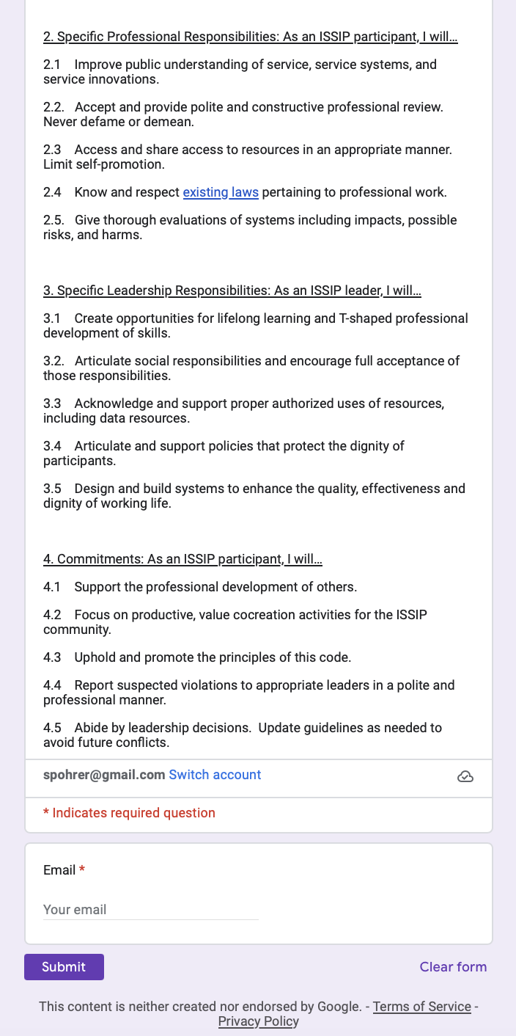
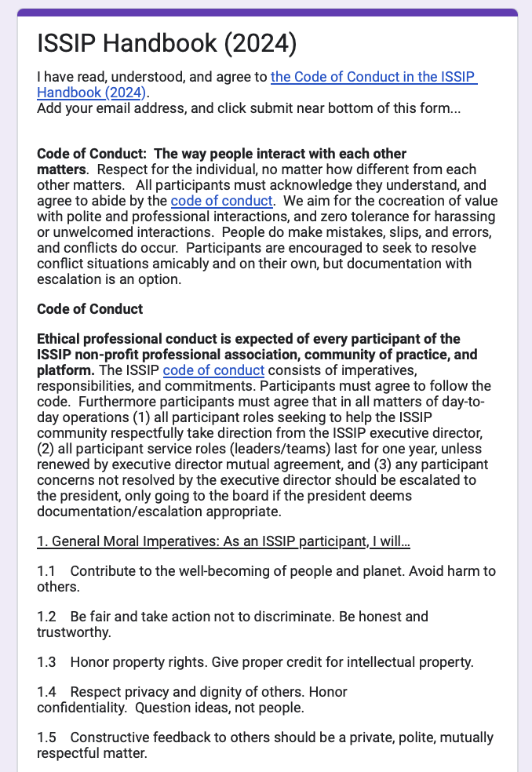
ISSIP 1: Code of Conduct
Find the Code of Conduct URL Link on Lower Right of Every ISSIP Website Page
https://docs.google.com/forms/d/e/1FAIpQLSfBolsKNgUOONASJy85qLAiJqye5IYCdhgMgFgRBOXFN1LyPA/viewform
Notes:
URL: https://docs.google.com/forms/d/e/1FAIpQLSfBolsKNgUOONASJy85qLAiJqye5IYCdhgMgFgRBOXFN1LyPA/viewform

Slide 19
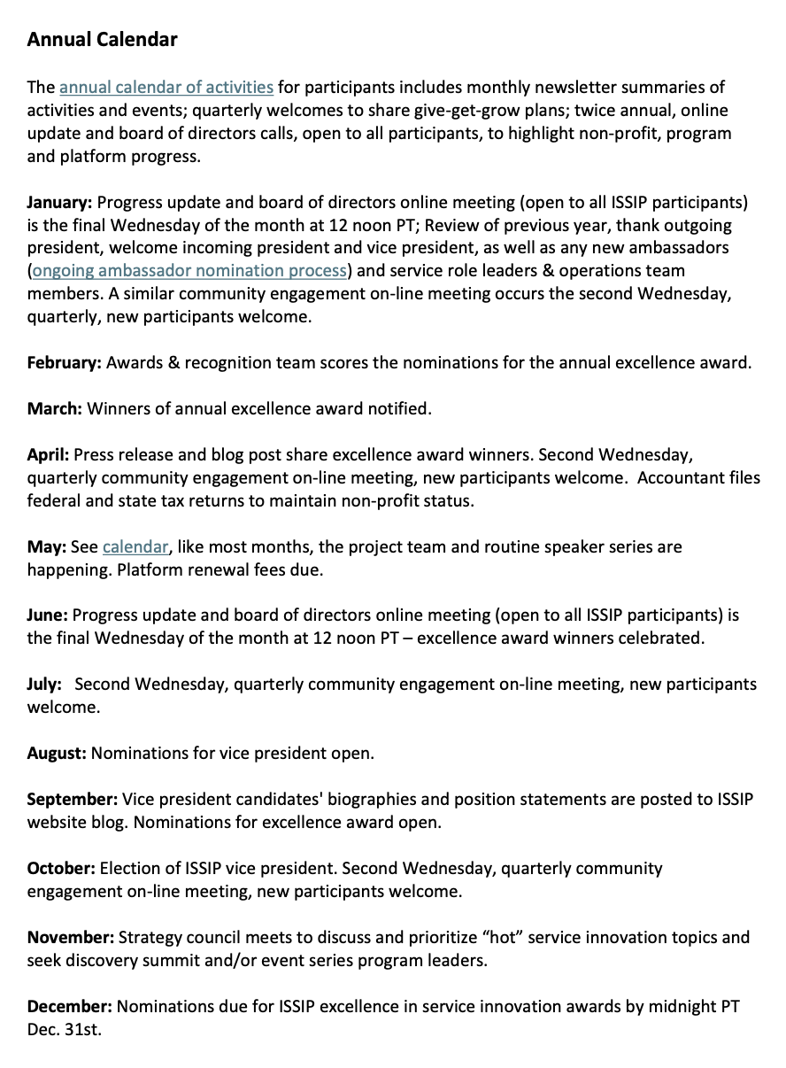
ISSIP 2: Annual Calendar
Each month there are standard events, etc.
Page 6 in Handbook: https://issip.org/wp-content/uploads/2024/08/ISSIP-Handbook-2024-Edition.pdf
Notes:
Page 6 in ISSIP Handbook
https://issip.org/wp-content/uploads/2024/08/ISSIP-Handbook-2024-Edition.pdf

Slide 20
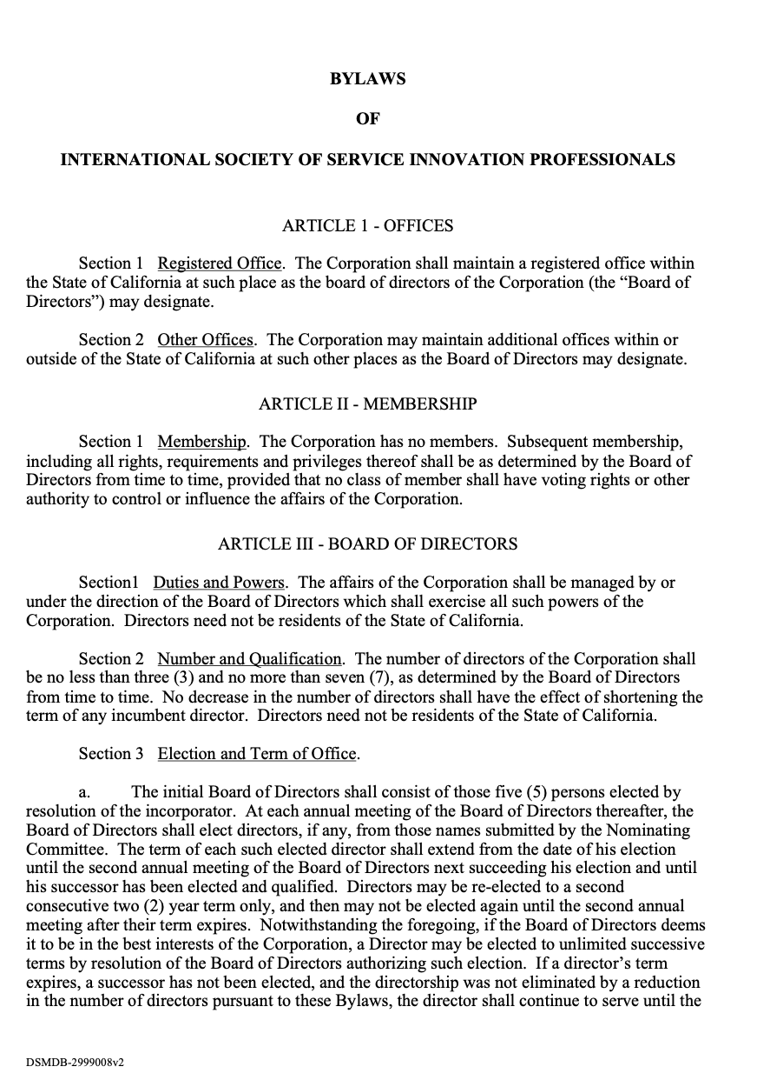
ISSIP 3: Bylaws - Nonprofit
Find the Bylaws URL Link on Lower Right of Every ISSIP Website Page
https://issip.org/wp-content/uploads/2024/07/ISSIP-Bylaws-Approved-02142014.pdf
Notes:
URL: https://issip.org/wp-content/uploads/2024/07/ISSIP-Bylaws-Approved-02142014.pdf

Slide 21
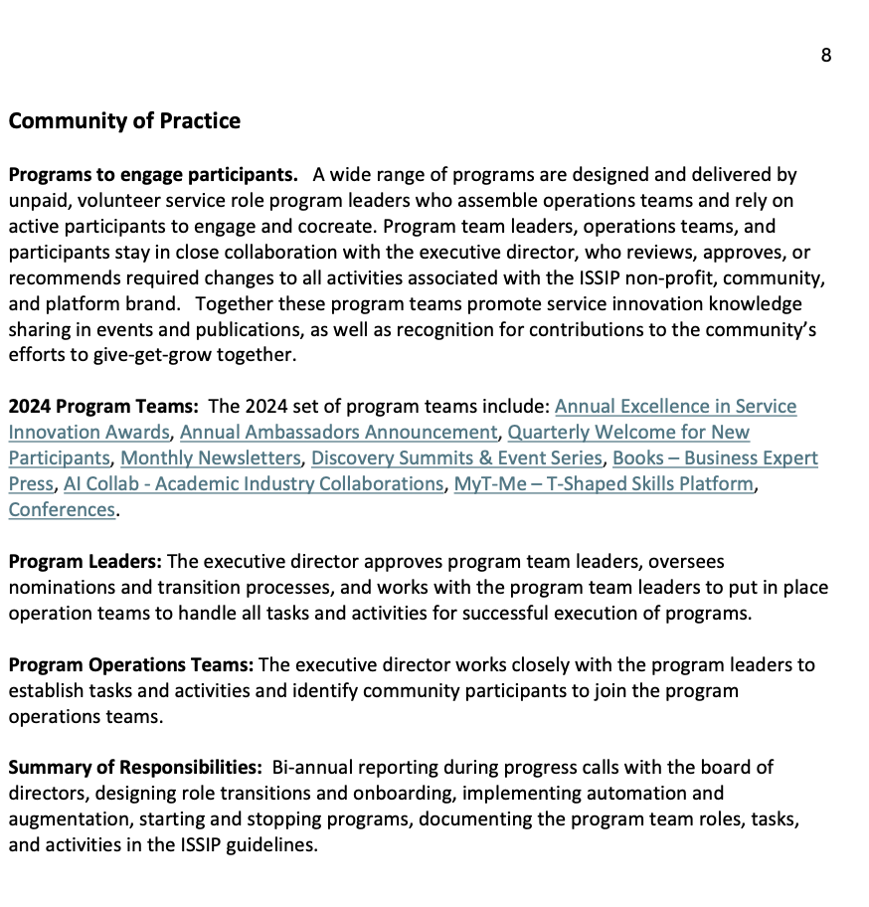
ISSIP 4: Programs – Community of Practice
Programs have volunteer leaders and operations teams
Programs are designed for give-get-grow
Share knowledge
Get recognition
Grow network
Page 8 in Handbook: https://issip.org/wp-content/uploads/2024/08/ISSIP-Handbook-2024-Edition.pdf
Notes:
Page 68 in Handbook: https://issip.org/wp-content/uploads/2024/08/ISSIP-Handbook-2024-Edition.pdf

Slide 22
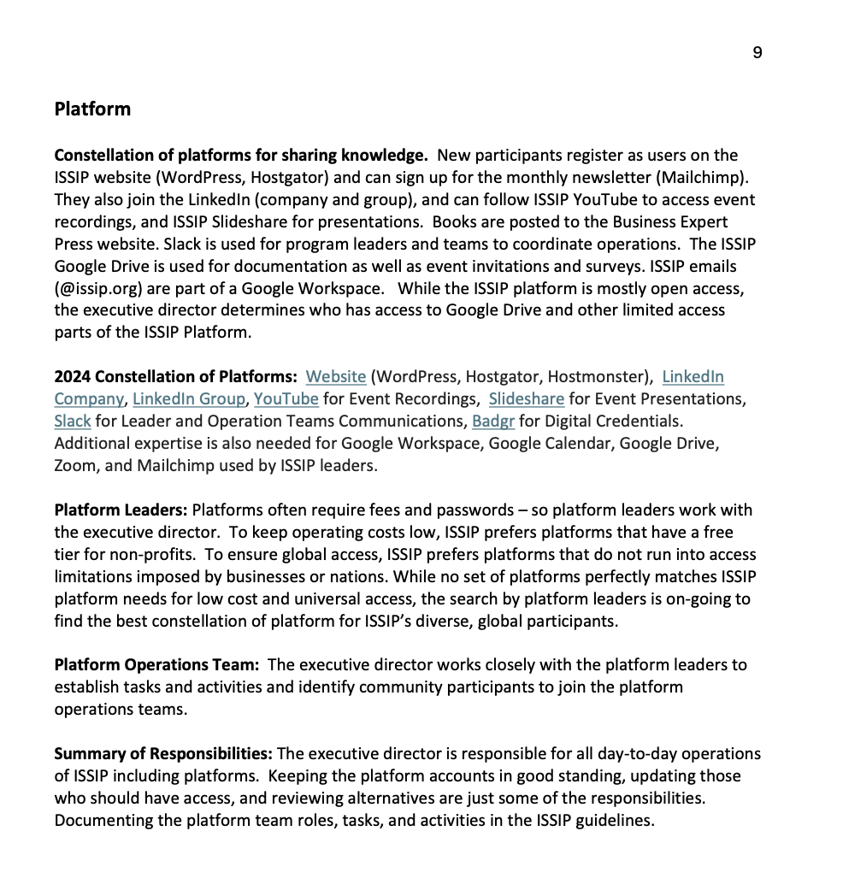
ISSIP 5: Constellation of Platforms
The constellation of platforms support ISSIP participants and the programs
The platforms also support:
Share knowledge
Get recognitions
Grow network
Page 9 in Handbook: https://issip.org/wp-content/uploads/2024/08/ISSIP-Handbook-2024-Edition.pdf
Notes:
Page 9 in Handbook: https://issip.org/wp-content/uploads/2024/08/ISSIP-Handbook-2024-Edition.pdf

Slide 23
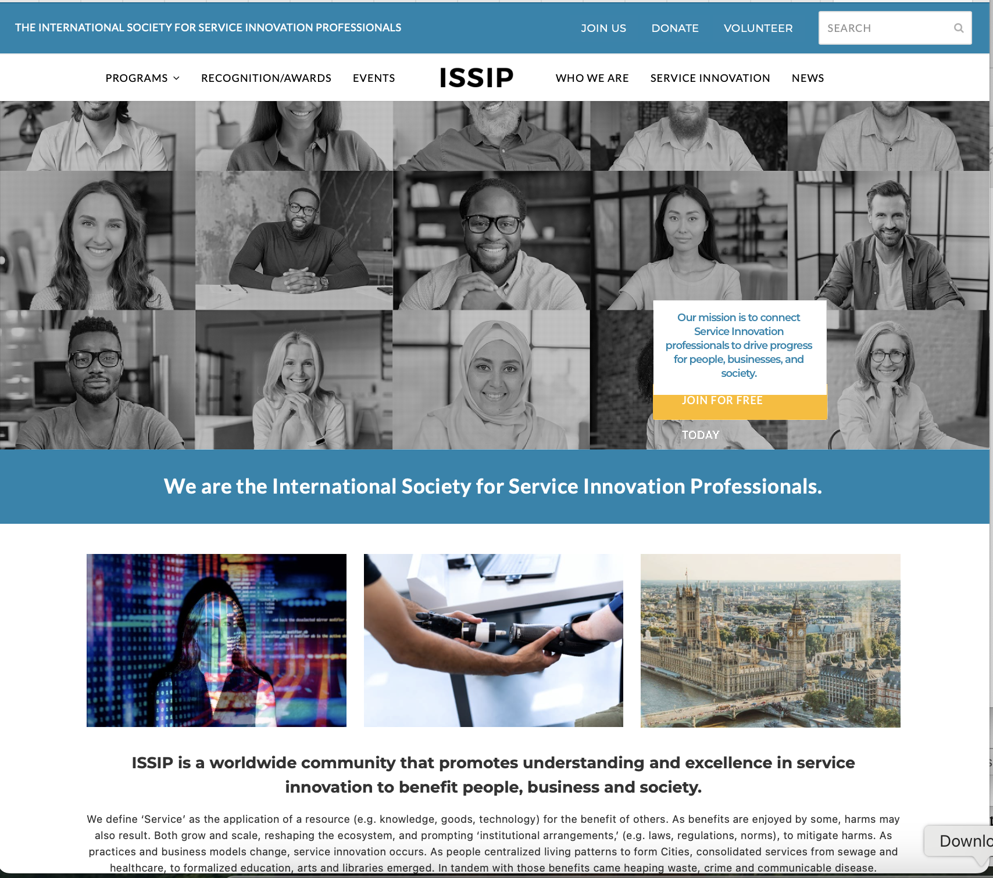
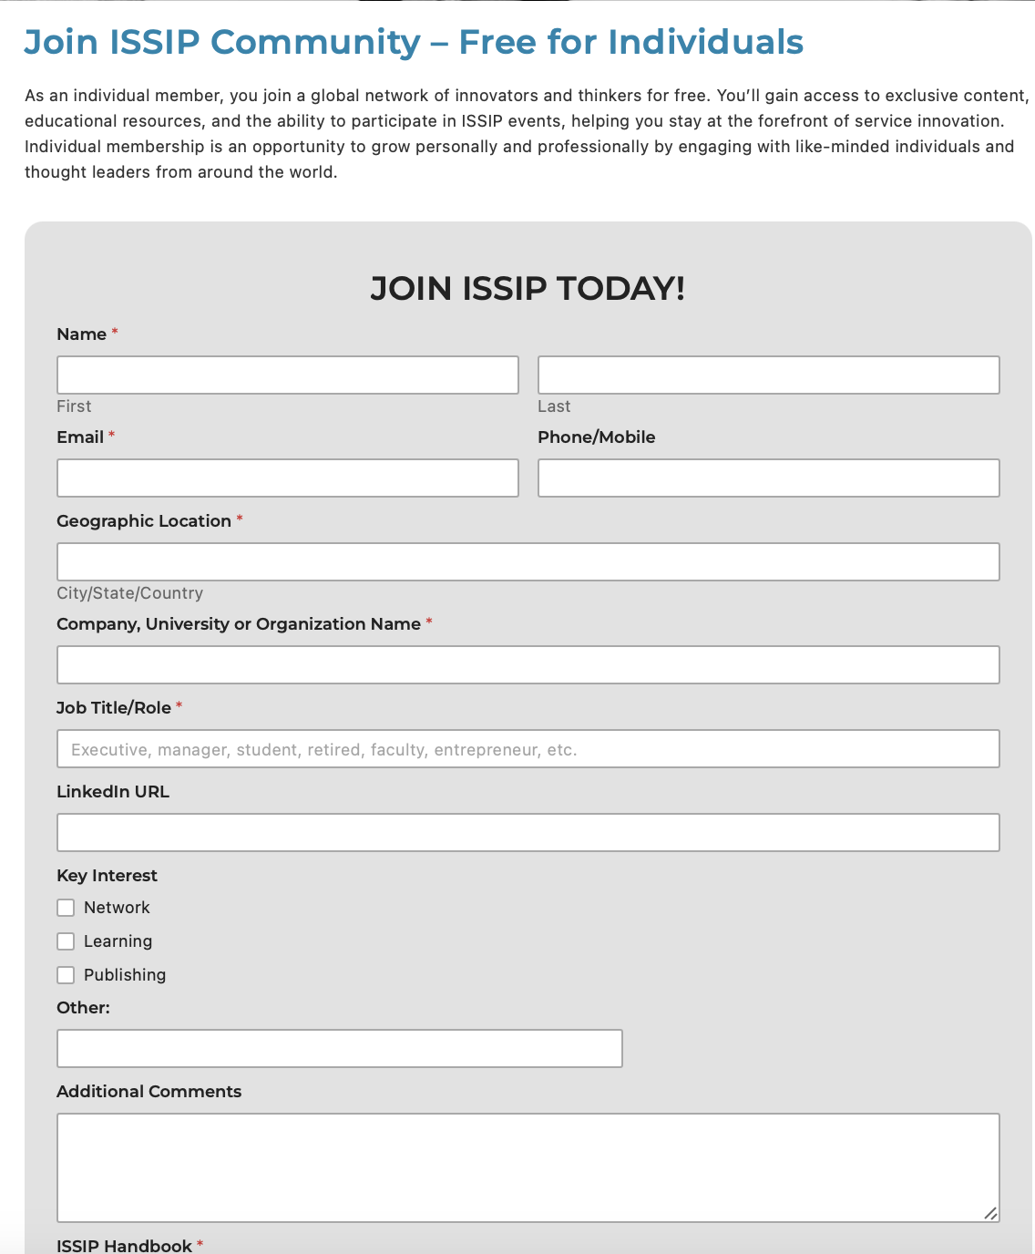
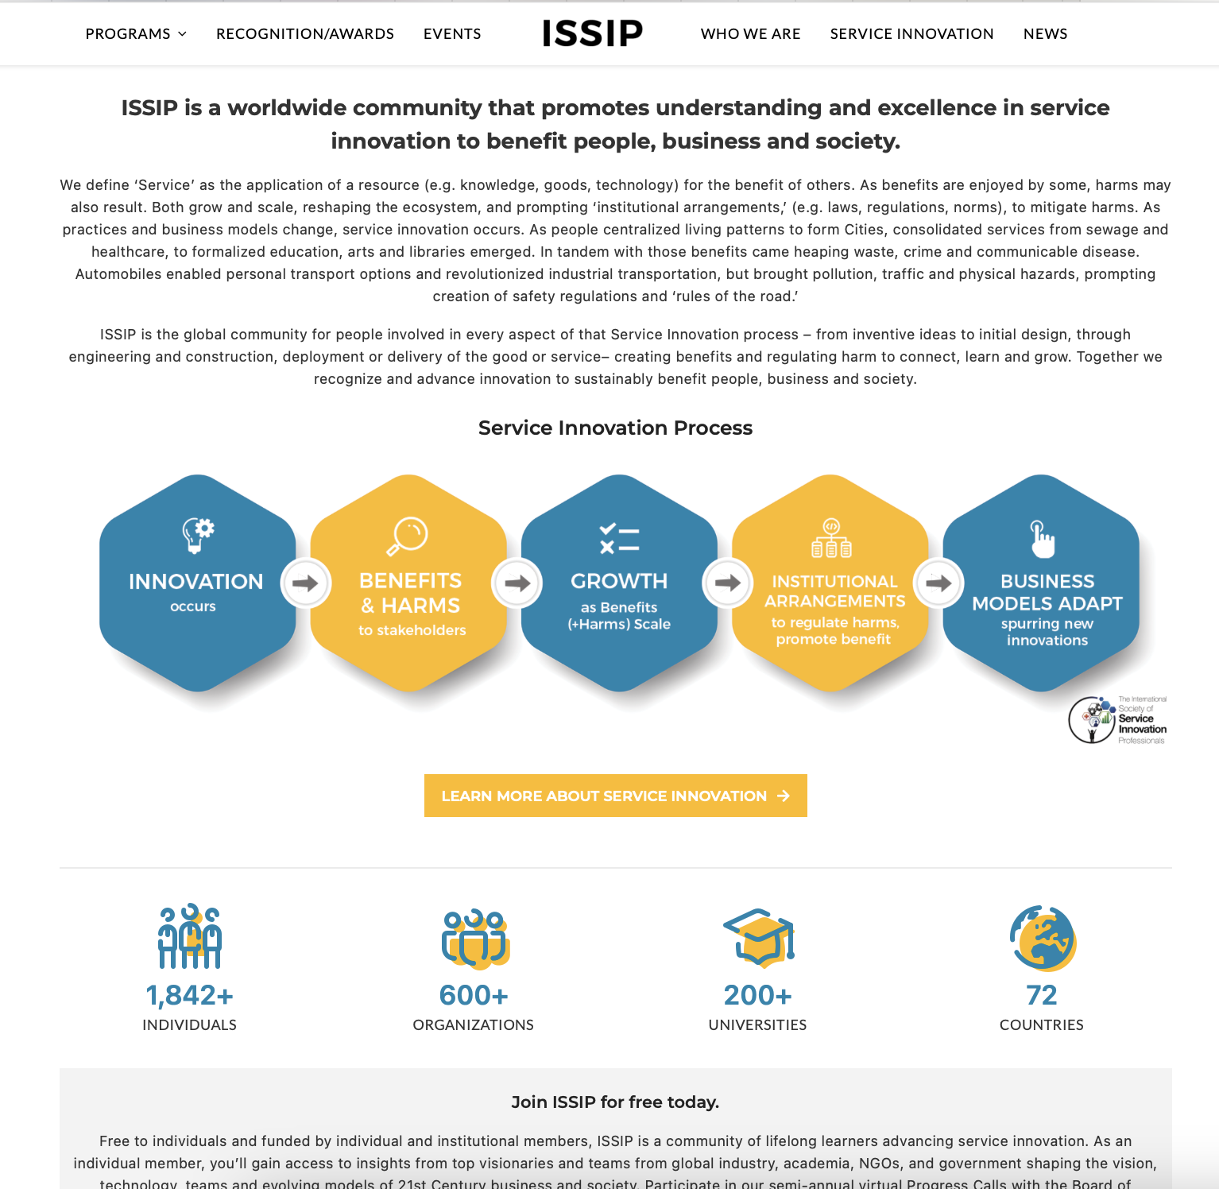
ISSIP 6: Website & Registration
All ISSIP Participants should explore the website and register at the website to become a participant and sign up for the monthly newsletter
http://issip.org
Notes:
https://issip.org

Slide 24
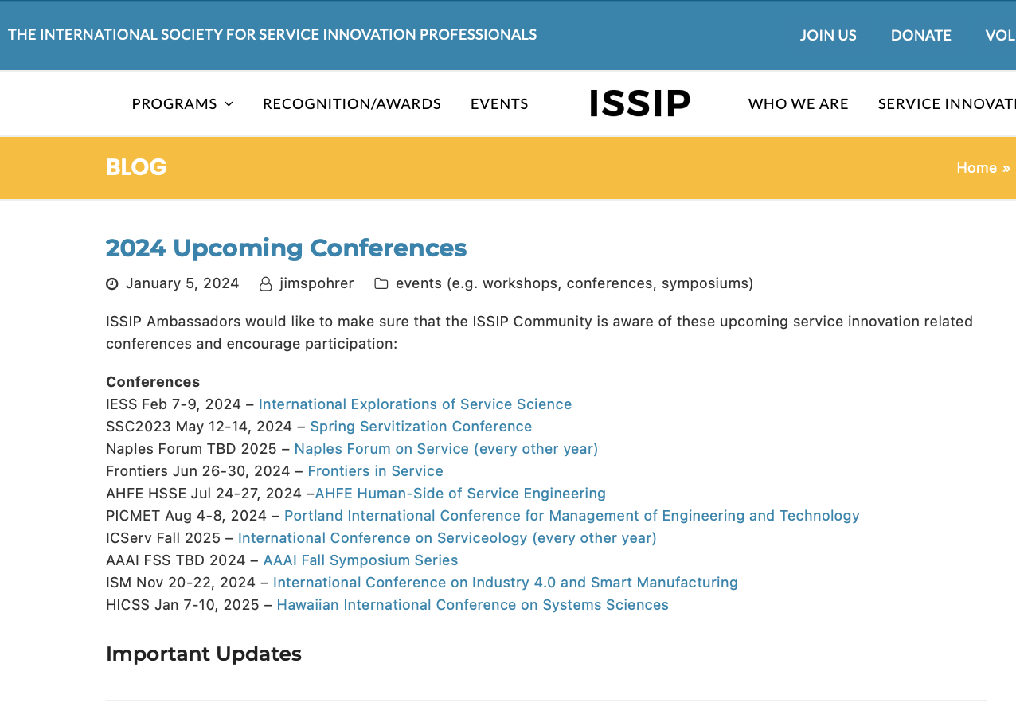
ISSIP 7: Conferences
Participants are invited to attend service-innovation-related conferences to publish papers and give talksand grow their networks.
https://issip.org/2024/01/05/2024-upcoming-conferences/
Notes:
URL: https://issip.org/2024/01/05/2024-upcoming-conferences/

Slide 25
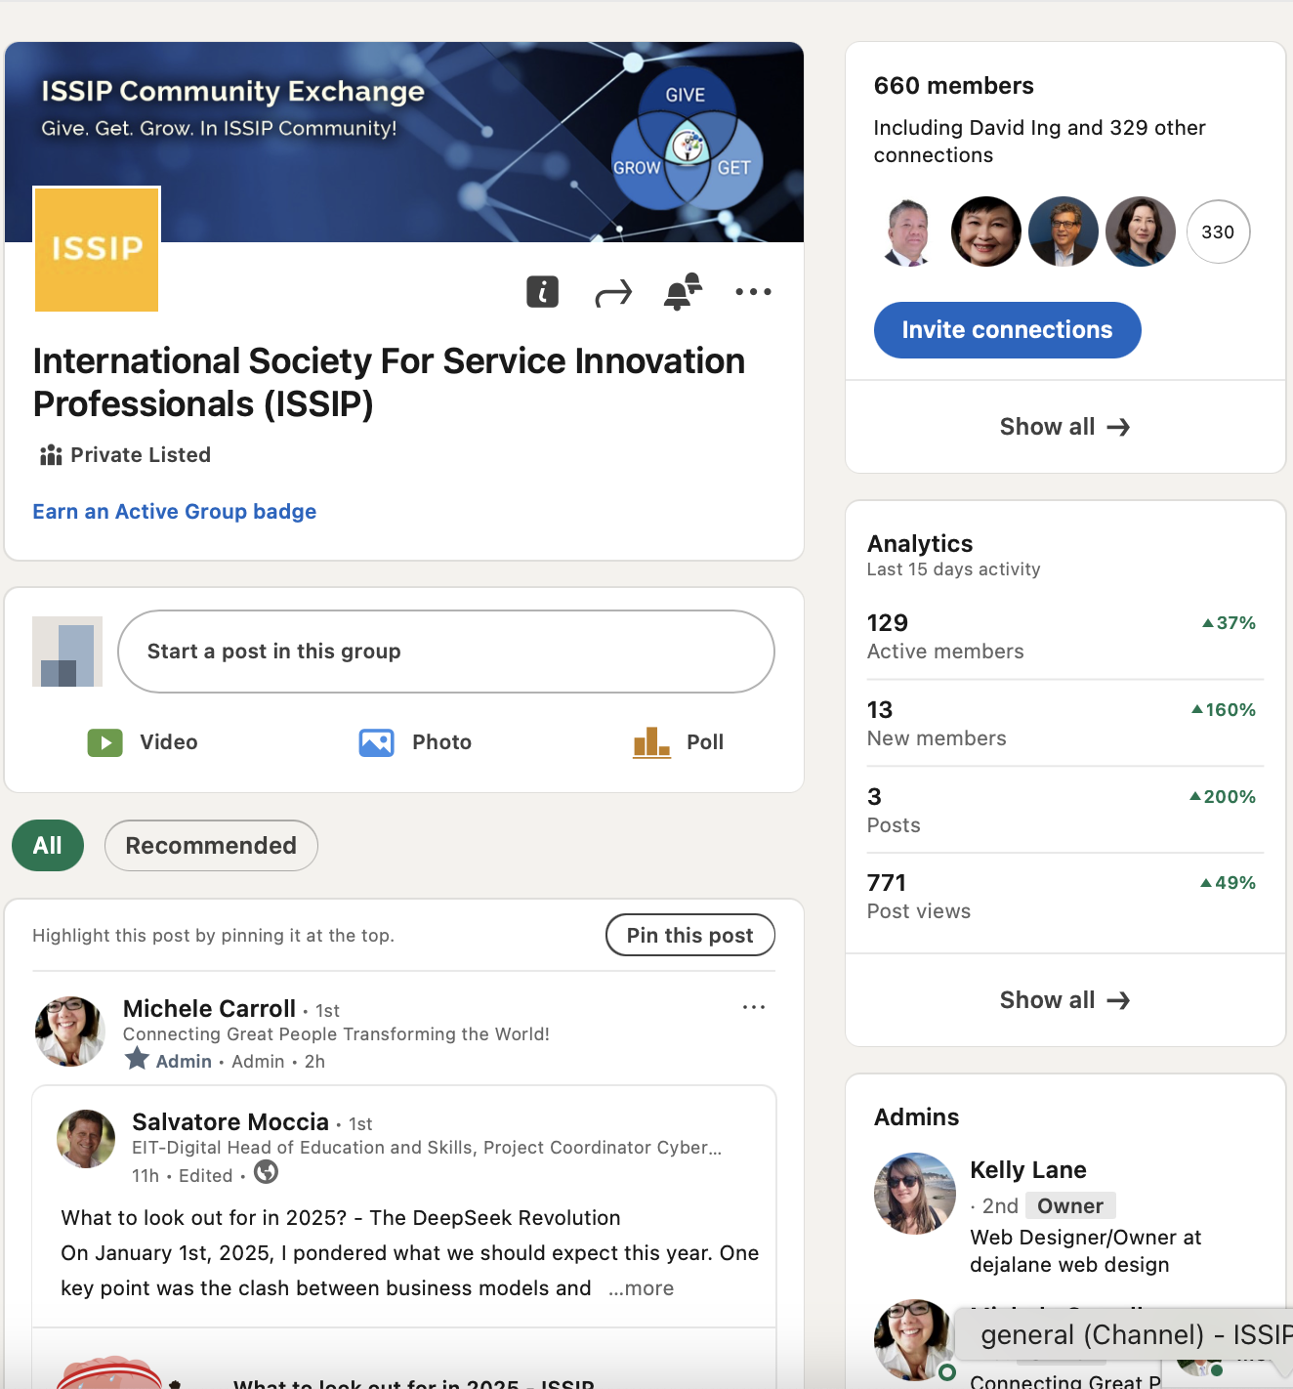
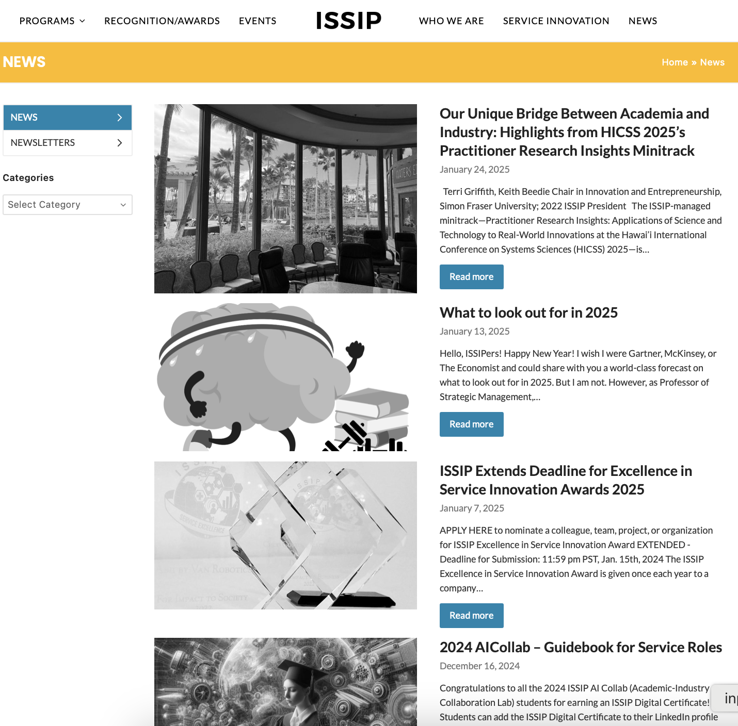
ISSIP 8: LinkedIn Group & Website Blog Posts
Participants can share short-updates on the ISSIP LinkedIn Group
Participants can share longer abstracts on topics on the ISSIP Website News/Blog Posts
https://issip.org/news/
https://www.linkedin.com/groups/4720974/
Notes:
News & Blog Posts
URL: https://issip.org/news/
LinkedIn Group
URL: https://www.linkedin.com/groups/4720974/

Slide 26
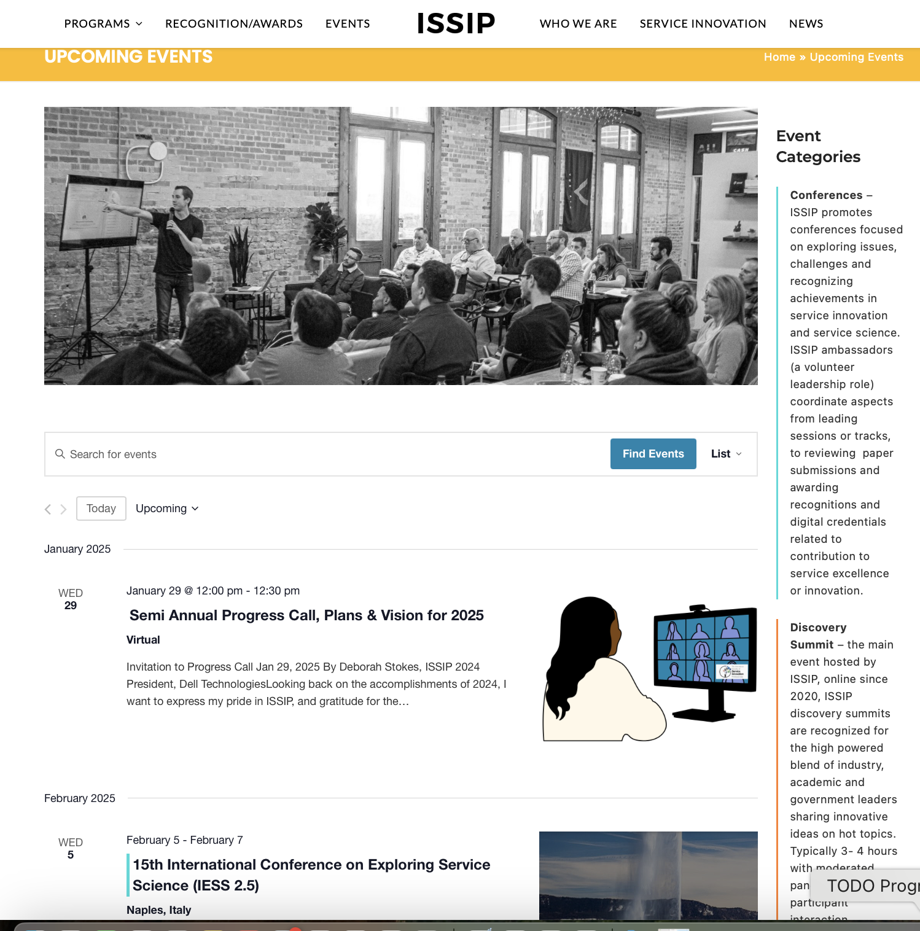
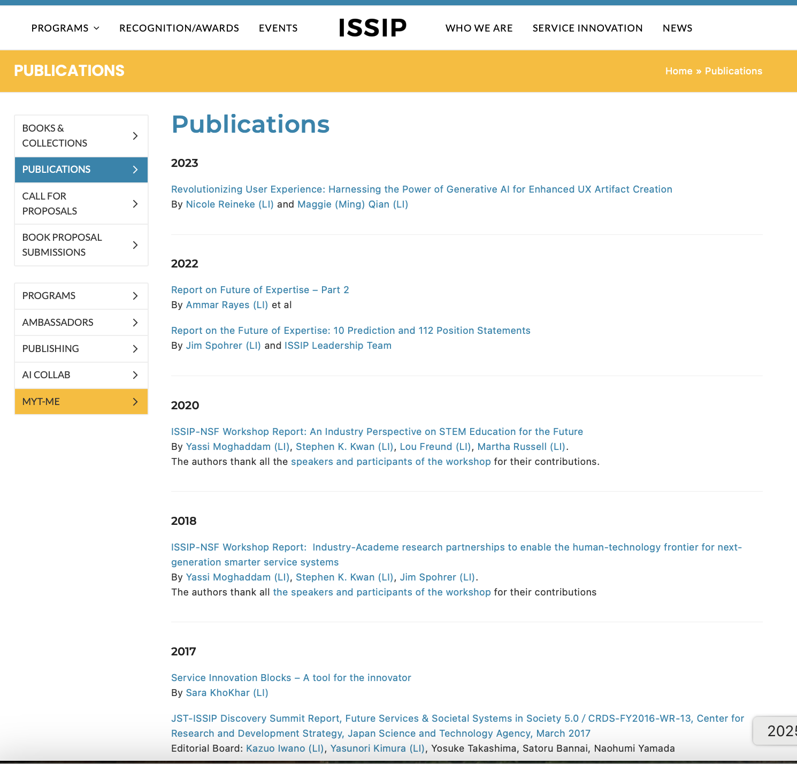
ISSIP 9: Event Series, Panels, and Whitepapers
To meet ISSIP leadership, register for the Progress Update with Board, last Wednesday in January and June.
To meet new ISSIP participants, register for the Quarterly Welcome, second Wednesday of January, April, July, October.
https://issip.org/upcoming-events/
Notes:
URL: https://issip.org/upcoming-events/

Slide 27
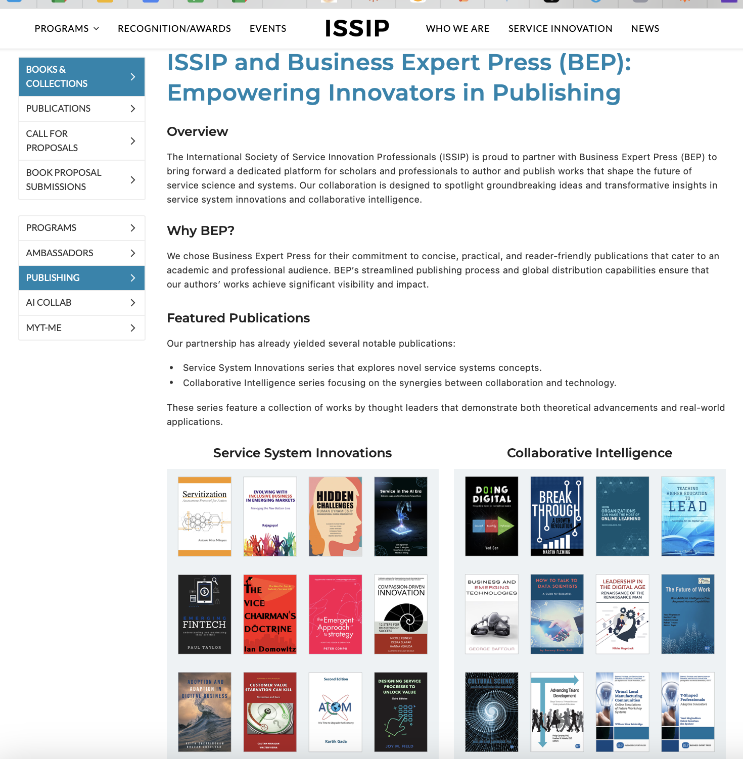
ISSIP 10: Books (Business Expert Press)
Ready to write a book? Many firsttime book authors helped by ISSIP.
https://issip.org/issip-and-bep/
Notes:
URL: https://issip.org/issip-and-bep/

Slide 28
Section C: Participation
Ten Learning Items
Culture: Give-Get-Grow Plan
Newsletter
Vote in ISSIP Annual VP Election
Encourage Nominations in ISSIP Excellence in Service Award
Follow ISSIP LinkedIn Company
Member ISSIP LinkedIn Group
Subscriber ISSIP YouTube Channel
Follower ISSIP Slideshare
Ambassadors
Support & Leadership (Benevity, Institutional Donations)

Slide 29
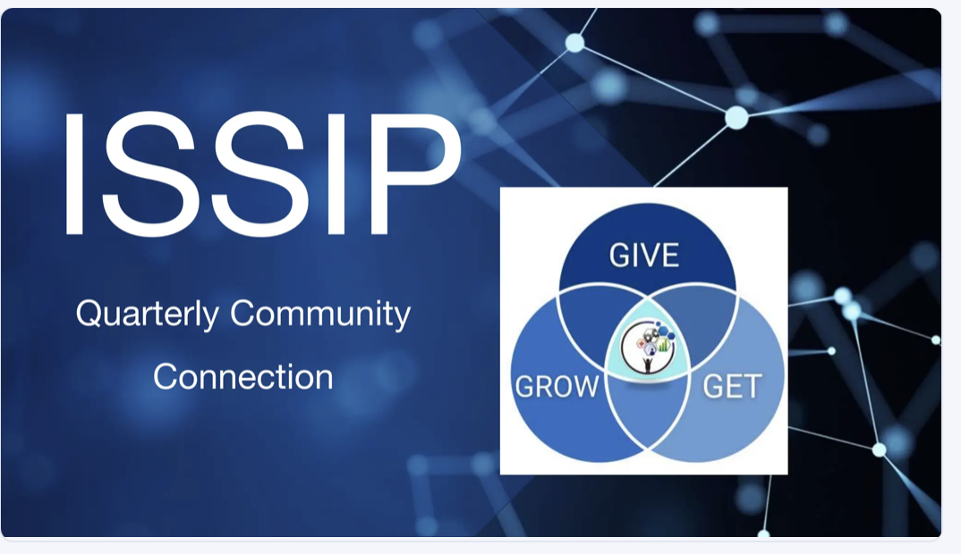
Participation 1: Culture of Give-Get-Grow
Students to careers to retirees
Give time & share knowledge
Get recognition
Grow network
Easy place to start to learn about service innovation
Friendly and informal
Keep the feel of a small organization where people can truly get to know each other as individuals
Limit self promotion, and focus on volunteering help to others
Becoming more helpful and of service to each other as lifelong learners
https://www.slideshare.net/slideshow/20240410-issip-ggg-qtrly-community-connection-slidespptx/267187516
Notes:
URL: https://www.slideshare.net/slideshow/20240410-issip-ggg-qtrly-community-connection-slidespptx/267187516

Slide 30
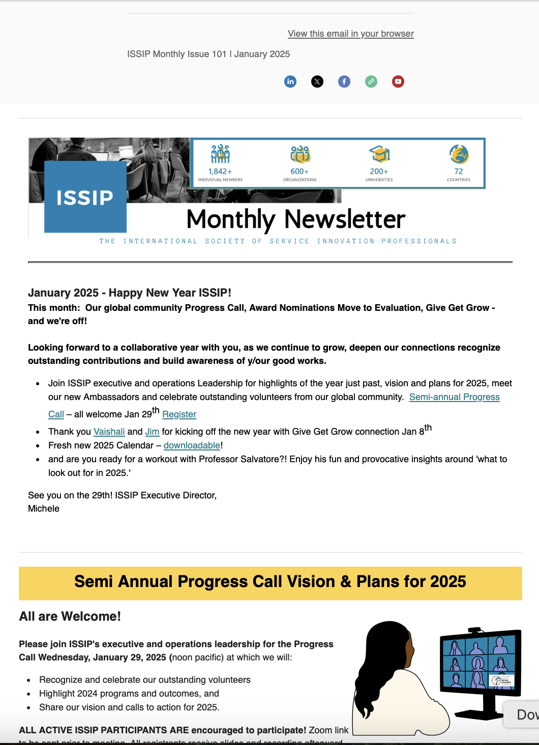
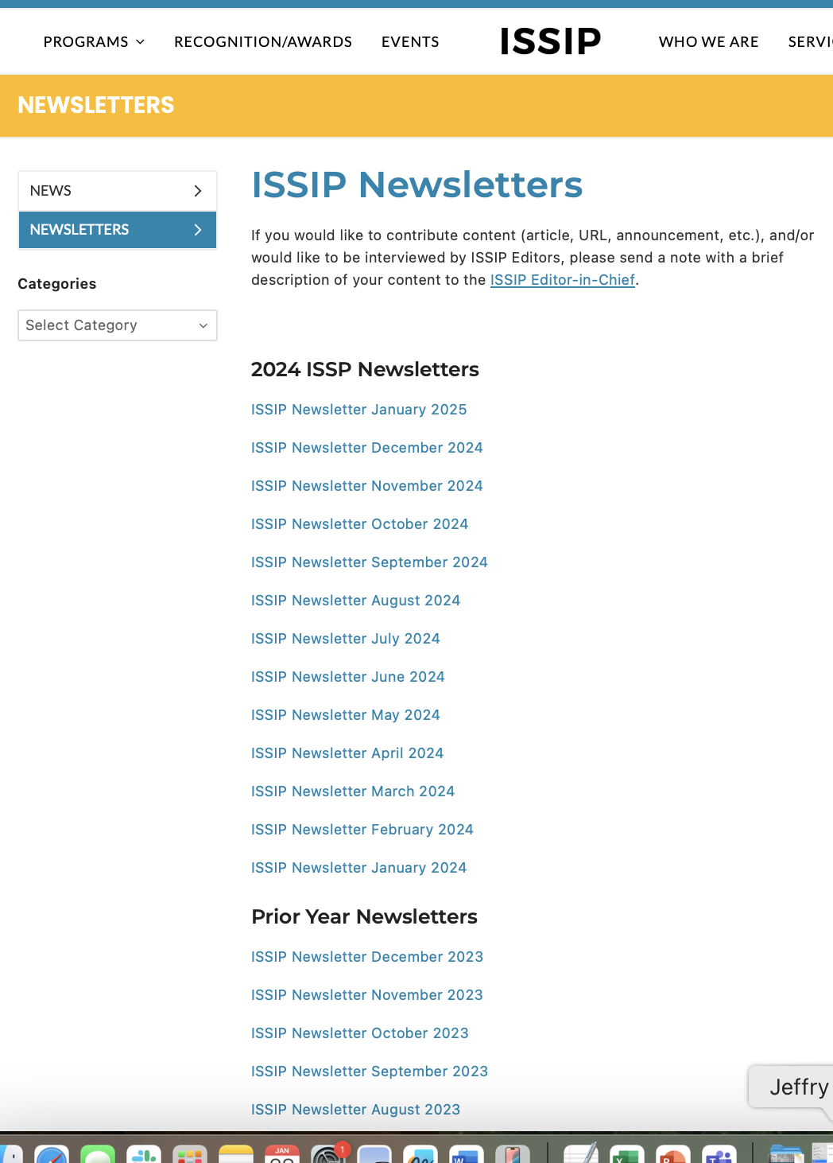
Participation 2: Newsletter
Monthly Newsletters
https://issip.org/newsletters/
Notes:
URL: https://issip.org/newsletters/

Slide 31
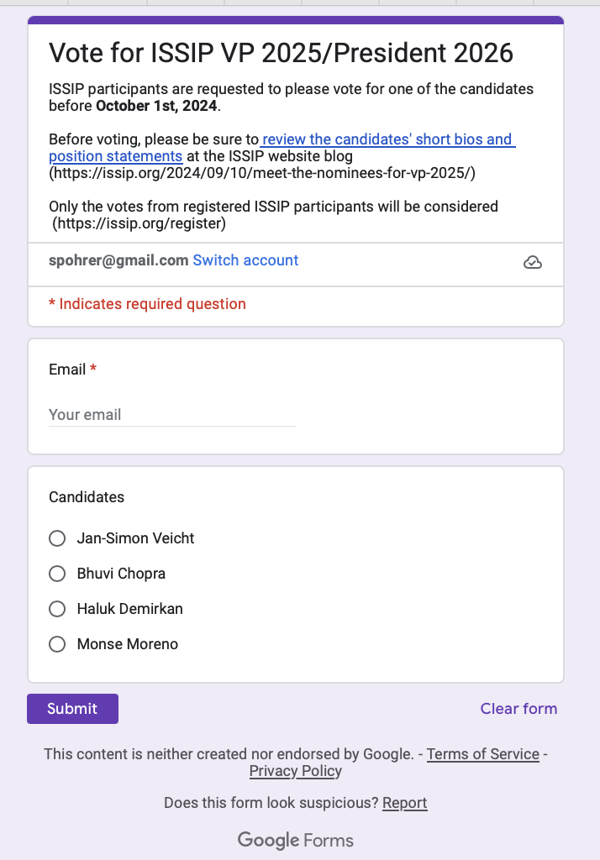
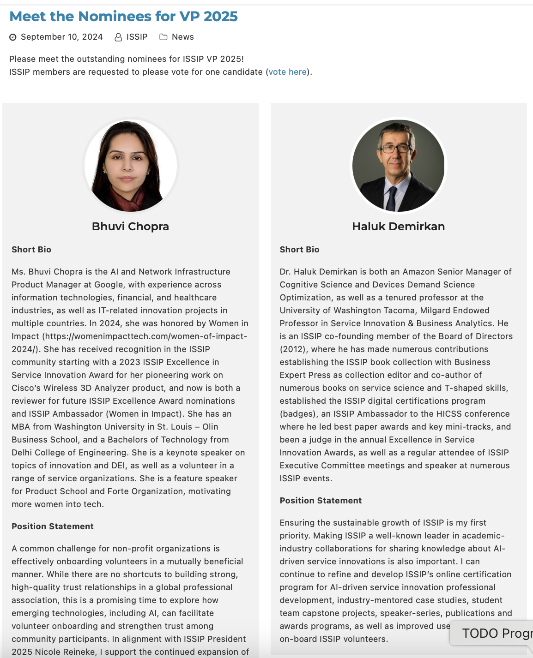
Participation 3: Vote in ISSIP VP Annual Election
August – VP Nominations
September – Voting
October – Selection & Announcement
https://issip.org/2024/09/10/meet-the-nominees-for-vp-2025/
Notes:
https://issip.org/2024/09/10/meet-the-nominees-for-vp-2025/

Slide 32
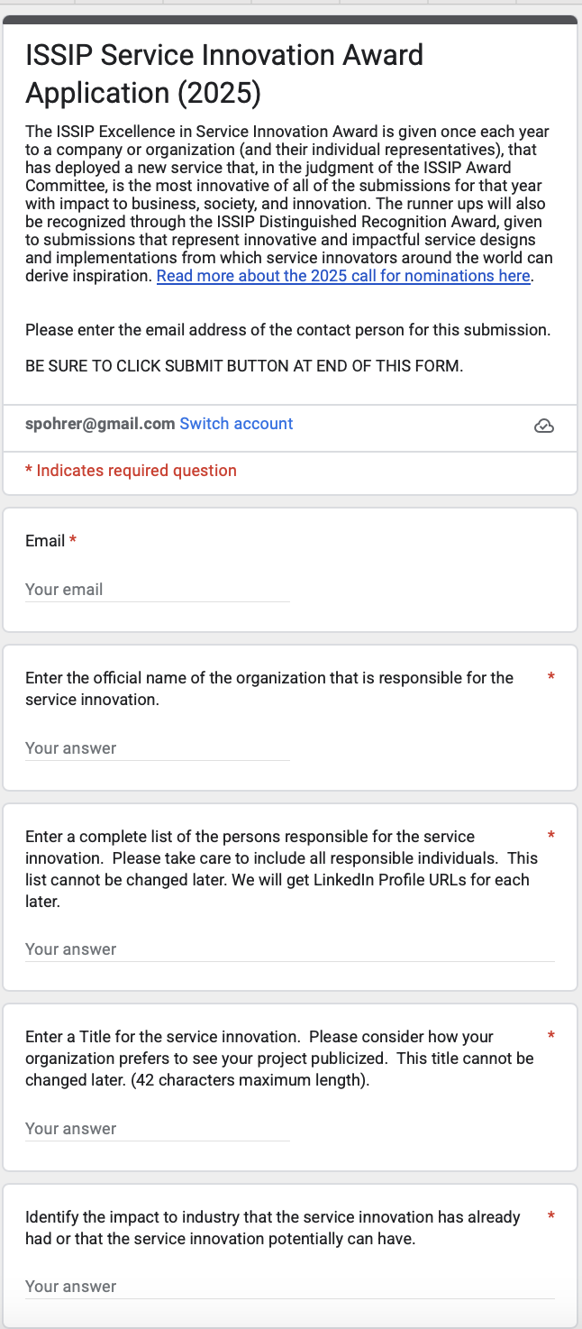
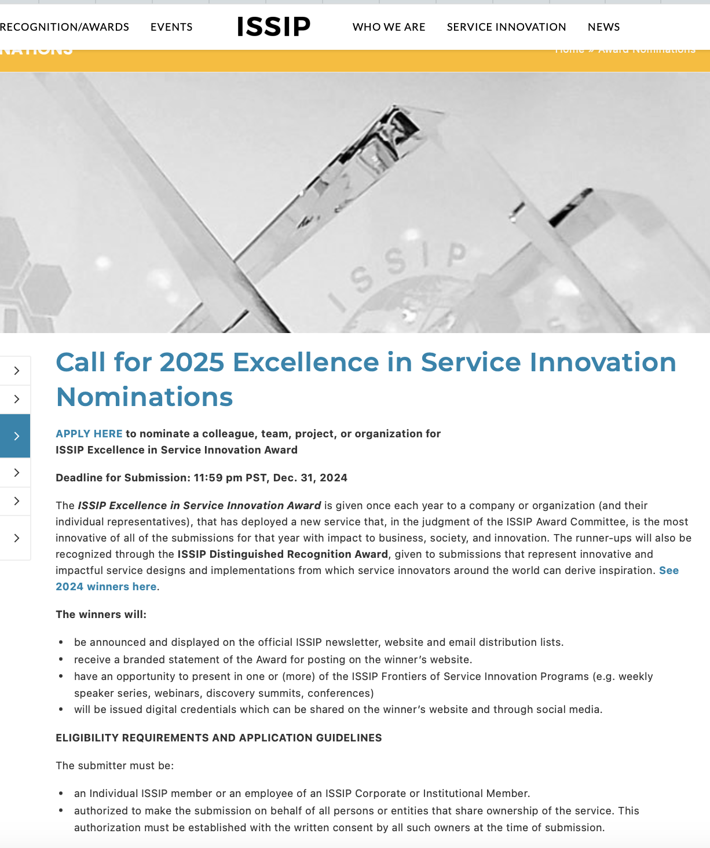
Participation 4: Encourage Nominations in ISSIP Excellence in Service Annual Awards
It takes less than an hour to make a nomination
Deadline December 31 each year
Winners Notified in March
Winners Announced in April
https://issip.org/award-nominations/
Notes:
https://issip.org/award-nominations/
https://docs.google.com/forms/d/e/1FAIpQLSdYEuEykcYnIEUL9gASo1amkpDqYMXa8hIkKCQem3yG83iIMA/viewform

Slide 33
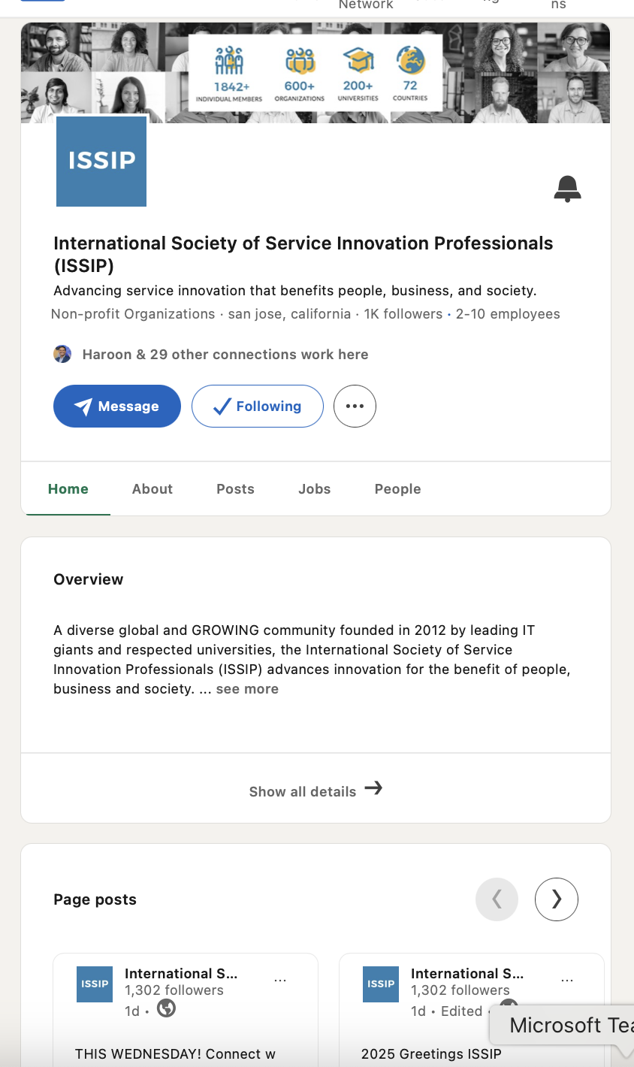
Participation 5: Become a follower of ISSIP LinkedIn Company
ISSIP Calendar Reminders and other posts from ISSIP Leadership can be found here
https://www.linkedin.com/company/international-society-of-service-innovation-professionals-issip-/
Notes:
https://www.linkedin.com/company/international-society-of-service-innovation-professionals-issip-/?viewAsMember=true

Slide 34
Participation 6: Become a Member of ISSIP LinkedIn Group
Participants share short posts
https://www.linkedin.com/groups/4720974/

Slide 35
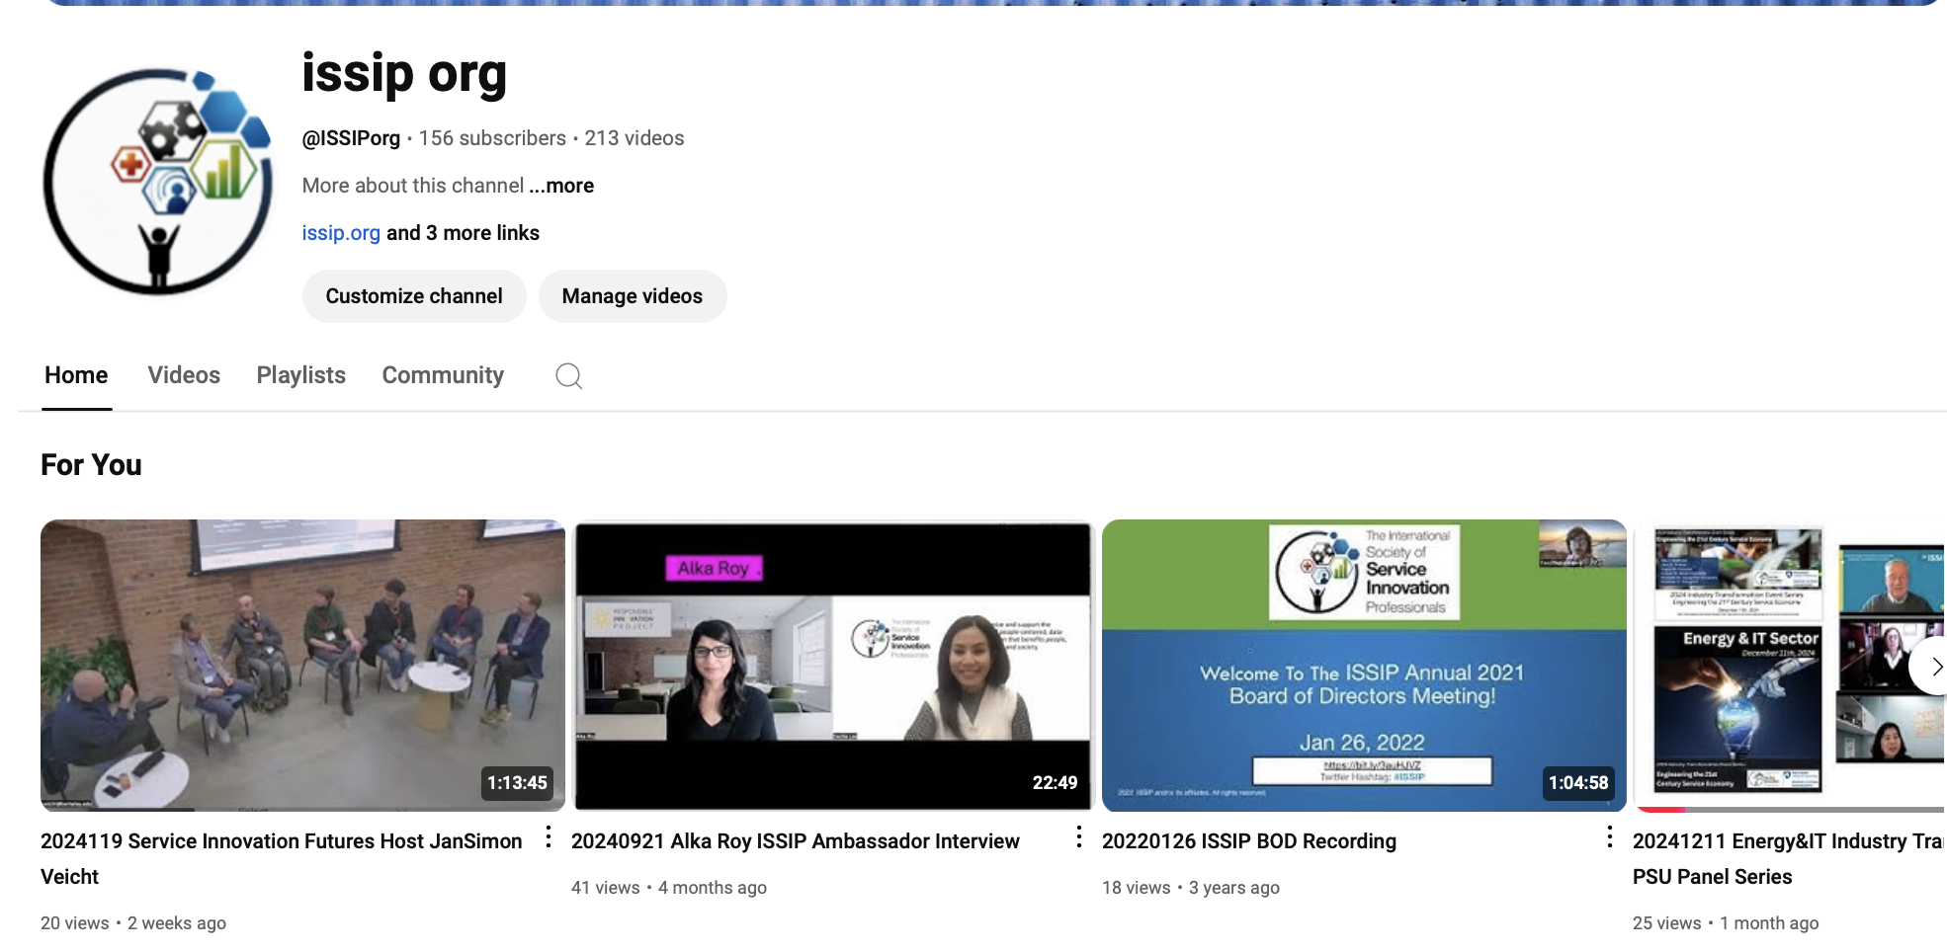
Participation 7: Become a Subscriber of ISSIP YouTube
Events are recorded to share with the community – which spans global time zones.
https://www.youtube.com/user/ISSIPorg
Notes:
https://www.youtube.com/user/ISSIPorg

Slide 36
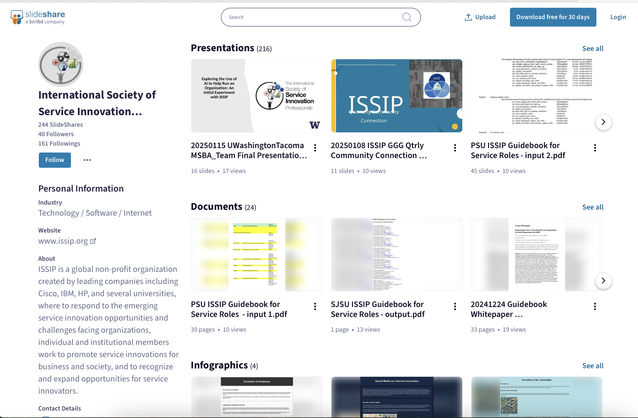
Participation 8: Become a Follower of ISSIP Slideshare
Event presentation are shared.
AI Collab deliverables including final presentation and whitepaper are shared here.
https://www.slideshare.net/issip
Notes:
https://www.slideshare.net/issip

Slide 37
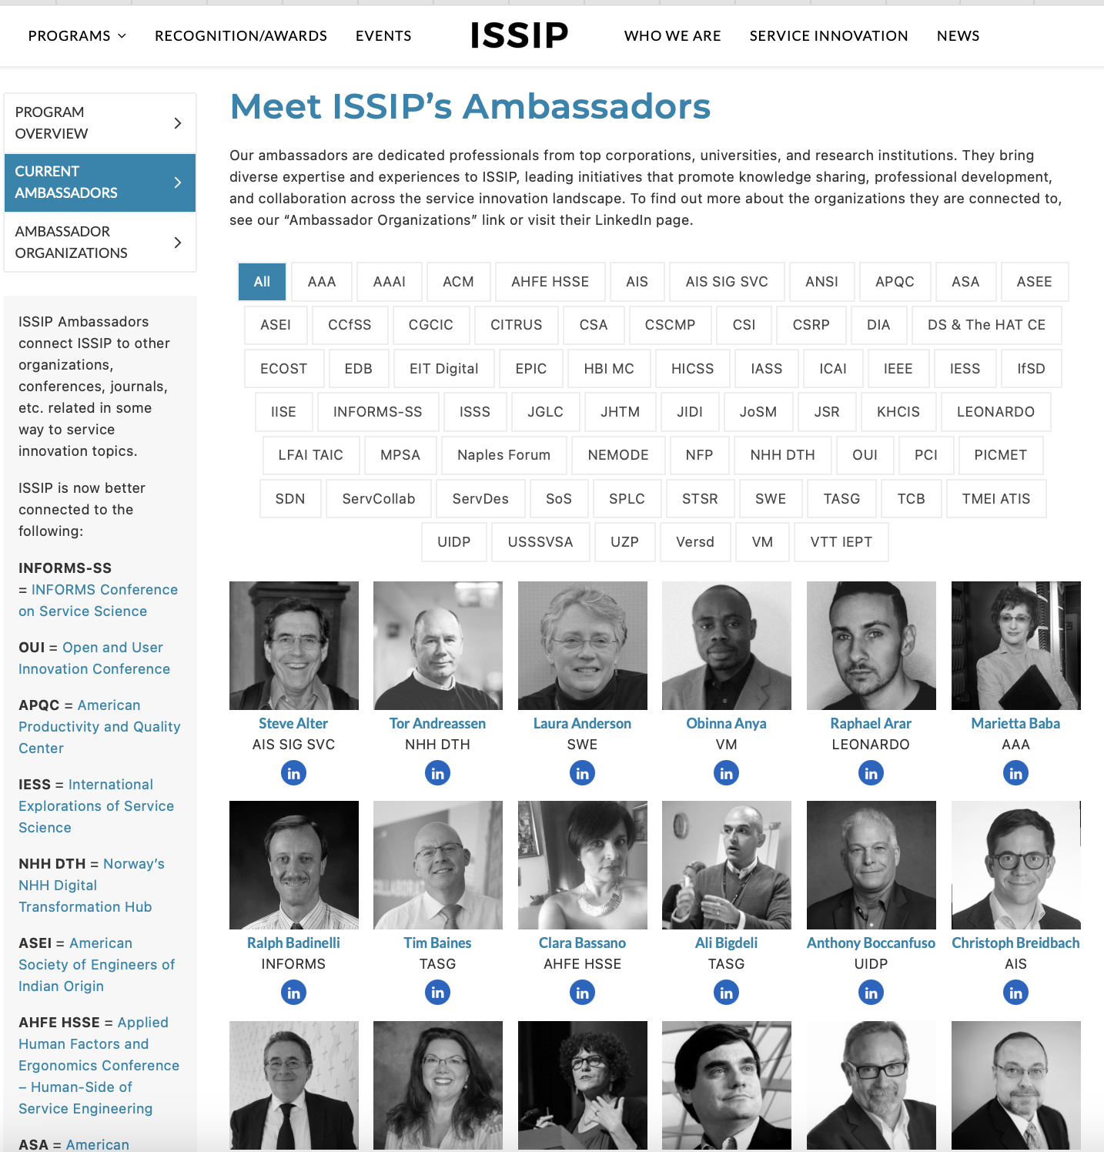
Participation 9: Follow ISSIP Ambassadors on LinkedIn
A great way to grow you networks is to follow ISSIP Ambassadors on LinkedIn.
Send connection requests to only those you know personally, or who you have studied their work, including ISSIP events.
https://issip.org/community/current-ambassadors/
Notes:
https://issip.org/community/current-ambassadors/

Slide 38
Participation 10: Volunteer Support (Benevity and Institutional Donations)
Benevity – log volunteer hours
Institutional Donations
Reimbursement for any individual donations for professional association participation fees or education/certifications fees
By design, ISSIP.org tries to keep operating costs low
Primary expense is Executive Director service to do community-of-practice program management, including website, newsletter, volunteer management, non-profit professional association donations, constellation of platforms upkeep.
Conference support, awards, platforms, and ISSIP Foundation monthly donations are other costs.
https://benevity.com
Notes:
https://benevity.com

Slide 39
Important – After
After taking the course, please take the post-test here.
https://docs.google.com/forms/d/e/1FAIpQLSfG_x6NQ6_qXahCch2i6E9yVmu7jtwefVX33nf4pYiJZG41zg/viewform
Notes:
Note: Responder Link versus Preview Link Important
Responder Link URL: https://docs.google.com/forms/d/e/1FAIpQLSfG_x6NQ6_qXahCch2i6E9yVmu7jtwefVX33nf4pYiJZG41zg/viewform

